Slide 1
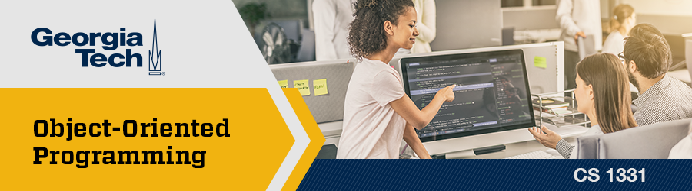
Recitation 4 /////

Slide 2
Announcements
PE03 due Thursday (09/16)
PE04 released Friday and due next Thursday (09/23)
Exam 1 next Friday (09/24)

Slide 3
Georgia Tech Academic Resources
Academic Resources:​
Office Hours​
Success Summit​
Academic Coaching​
Free 1-to-1 Tutoring ​
PLUS sessions ​
Compilation of all academic resources: here​
Mental Health Resources:​
Peer Coaching​
Counseling Appointments​
Psychiatry Appointments​
Group Therapy sessions​
Compilation list of all mental health resources: here
Disability Resources:​
Office of Disability Services​
Dean of students
Professor’s Compilation of Resources:​
National Resources and Campus Resources

Slide 4
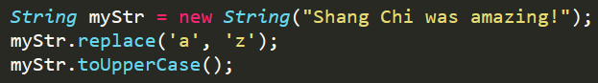
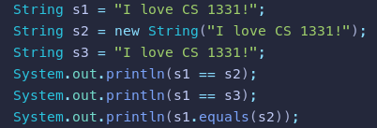
Pre-Quiz
What value does myStr point to?
What is printed to the console?
System.out.printf(“You ordered %s burgers%n for $%8.2f”, 5, 300.4899);
(T/F) Scanner is contained in the java.lang package.
What gets printed to the console?
Do these methods have the same signature?
"public int foo(int a, int b) {}" and "private int foo(int a, int b)"
"public int bar(int a, double b)" and "public int bar(int x, double y)"

Slide 5
Pre-Quiz
What is the value of myStr?
What is printed to the console?
System.out.printf(“You ordered %s burgers%n for $%8.2f”, 5, 300.4899);
(T/F) Scanner is contained in the java.lang package.
What gets printed to the console?
Do these methods have the same signature?
"public int foo(int a, int b) {}" and "private int foo(int a, int b)"
"public int bar(int a, double b)" and "public int bar(int x, double y)"
“Shang Chi was amazing!”
“You ordered 5 burgers
for $ 300.49”
False, in java.util
false, true, true
yes
yes

Slide 6
Topics List
Classes and Objects
Strings
Console I/O
Packages
Math & Random classes
Enums
Checkstyle

Slide 7
Reference Types (Objects) and Classes
Variables that are an Object/reference type hold a reference to the Object’s location in memory.
Object types start with an uppercase letter by convention.
How do you initialize a reference type variable?

Slide 8
Reference Types (Objects) and Classes
Variables that are an Object/reference type hold a reference to the Object’s location in memory.
Object types start with an uppercase letter by convention.
How do you initialize a reference type variable?
String s = new String();

Slide 9
Strings
Are objects -- not a primitive data type
Used to represent a sequence of characters
Strings are immutable meaning you cannot change them
Strings can be created the following ways:
String aStr = "Welcome to Recitation 3!";
String aStr = new String("Welcome to Recitation 3!");
String concatenation
"H" + "E" + "L" + "L" + "O" = "HELLO"
"12" + "3" = "123"

Slide 10

compareTo()
Used to compare objects- such as Strings
Primitives are compared using the reference equality operator (==)
The method is case sensitive, so in order for it to return 0 then both strings have to be exactly the same

Slide 11
equals()
Strings can also be compared using the equals() method
Ex. aStr.equals(aStr2)
The equals() and compareTo() methods compare the values of variables instead of the references

Slide 12
String Methods
String operations return a new String Object so you must reassign the result to a String variable
We will also show you the Java API: https://docs.oracle.com/javase/7/docs/api/java/lang/String.html
String b =
a.replace(char old, char new);
a.toLowerCase();
a.toUpperCase();
a.substring(int beginningIndex, int endingIndex);
a.substring(int beginningIndex);
a.length();
a.indexOf(char characterInString);
a.concat(String anotherString);

Slide 13
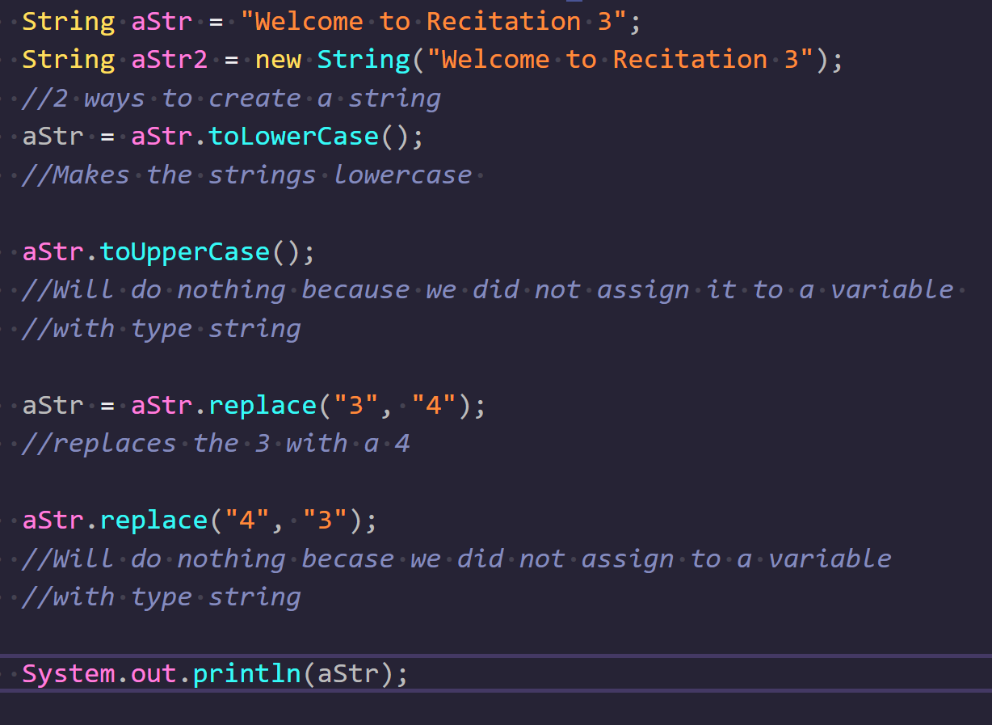
Strings Example
Output:

Slide 14
Command Line Output
System.out.print() - prints on the current line
System.out.println() - prints and then adds a new line character at the end
System.out.printf() - prints with formatting depending on the specifiers

Slide 15
Printf
%[flags][width][.precision]conversion-character
Conversion characters
s - formats strings
d - formats decimal integers
f - formats the floating-point numbers
B - formats booleans
c - formats characters

Slide 16
Numerical Formatted Print Example
System.out.printf("%9.3f", 3.14)
The number 9 specifies the minimum width of the formatted float (including the dot).
The number 3 specifies how many places the number should be rounded to.
The character f specifies the conversion character.
_ _ _ _ _ . _ _ _
1 2 3 4 5 6 7 8 9
_ _ _ _ 3 . 1 4 0
4 spaces to the left!

Slide 17
Command Line Input: Scanner
The Scanner class allows us to get user input by breaking it up into tokens (whitespace by default).
Must import java.util.Scanner;
You can create a Scanner as follows:
Scanner myScanner = new Scanner(System.in);
Always create just one Scanner!
Useful to read user input or read from files
Using scanners to read files will be covered later in the semester

Slide 18
Packages
A package is a collection of related classes that lets us implement things that we don’t have to code ourselves
A useful way to picture each package is as a folder filled with various classes
List of packages included with the Java API
java.lang (automatically imported)
java.io
java.math
java.text
java.util
java.awt
We can import a package as a whole with import java.util.*;
However, it is preferred to import individual classes with import java.util.Scanner;

Slide 19
Math Class
No, not like Calc 2, don’t worry
Contains many useful static methods allowing you to perform common mathematical operations.
Math.sqrt(double a)
Math.round(double a)
Math.min(double a, double b)
Math.max(double a, double b)
Math.pow(double a, double b) // a^{b}
Math.abs(double a) // absolute value
One very important method:
Math.random() //produces a pseudo-random value in range of [0.0, 1.0)
Math lives in java.lang -- it is automatically imported

Slide 20
java.util.Random
Java’s built in Random class allows us to generate pseudo-random numbers with a bit more customization
Requires instantiating as an object to use, similar to Scanner
Random rand = new Random();
Useful methods:
rand.nextInt(); //produces a random int in the range [−2147483648, 2147483647]
rand.nextInt(int bound); //produces a number in the range [0, bound)
rand.nextDouble(); //similar to Math.random(), returns double in bounds [0.0, 1.0);

Slide 21
Enums
Represent a group of unchangeable values (constants)
public enum Holidays {
NEW_YEARS, VALENTINES_DAY, ST_PATRICKS_DAY, INDEPENDENCE_DAY, BRAZIL_SOCCER_GAME_DAY
}
Help limit options for user input, so we can catch errors at compile time
Important Enum methods: name( ), ordinal( )
name() - returns the name of the enum in the form of a String. // Holidays.NEW_YEARS.name() ----> “NEW_YEARS”
ordinal() - returns the enum’s index in the declaration. In this example, VALENTINES_DAY has an ordinal of 1.
// Holidays.VALENTINES_DAY.ordinal() ----> 1

Slide 22
Checkstyle setup
Checkstyle is a tool we can use to enforce good coding style
To use it on your code, first download the jar file from Canvas and type the following into your terminal
java -jar [location and name of checkstyle jar] [name and location of .java file to run it on]
Ex: java -jar /users/you/downloads/checkstyle-8.28.jar MyJavaFile.java
You can move and rename the Checkstyle jar file to the same location as your .java file to make the command as simple as “java -jar checkstyle-8.28.jar MyJavaFile.java”
Checkstyle setup instructions can be found in the Canvas Modules section
Note: If you are using Sublime make sure you set “translate_tabs_to_spaces” to true

Slide 23
Coding Activities!
TAs will now go through the coding activities!

